Slide 1

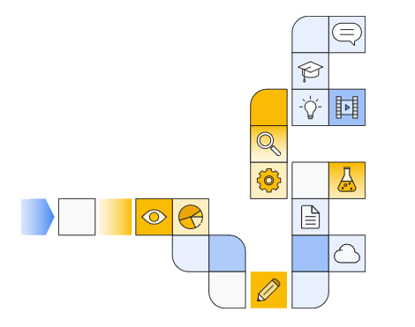

Google cloud generative ai overview Part 6
Notes:
https://www.cloudskillsboost.google/paths/118/course_templates/388

Slide 2
What are generative ai and LLMs
Notes:
https://www.youtube.com/watch?v=6ozwh4ETwiw

Slide 3
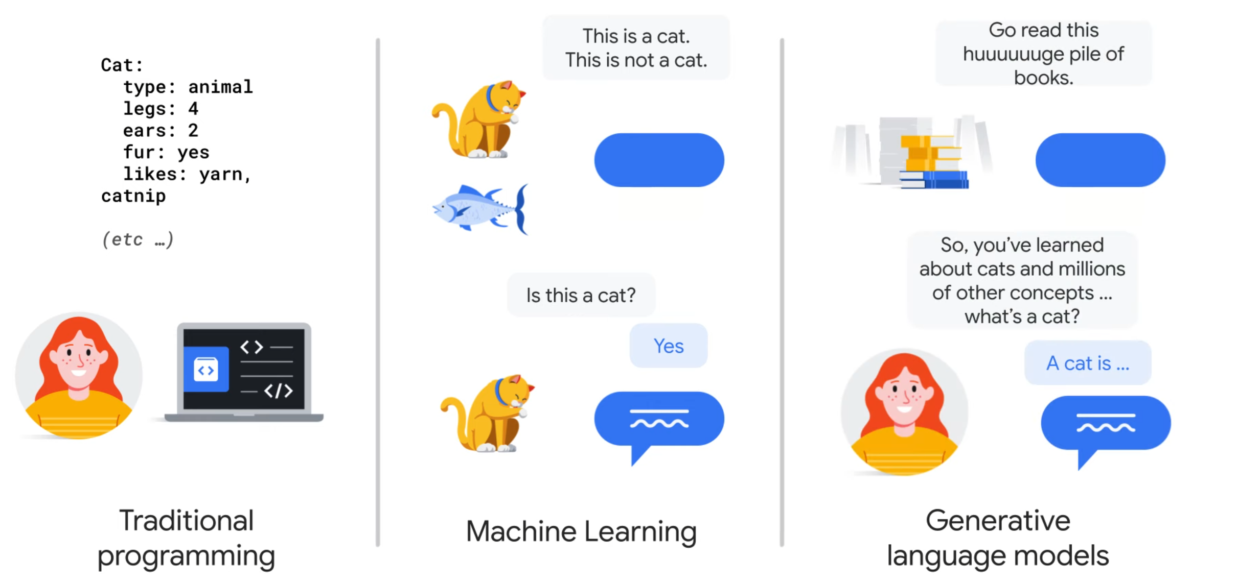

Slide 4
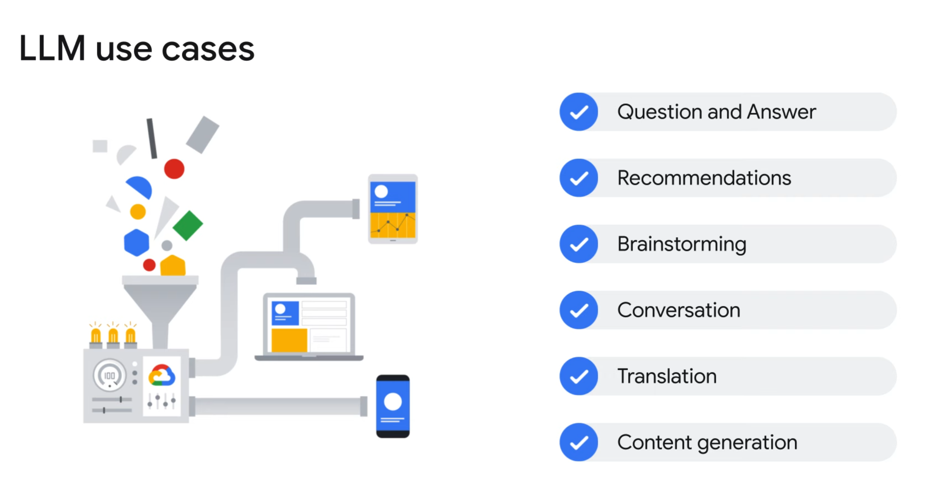

Slide 5
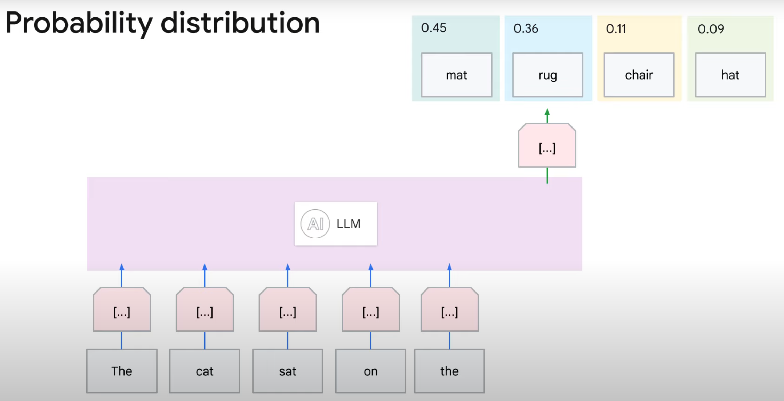

Slide 6
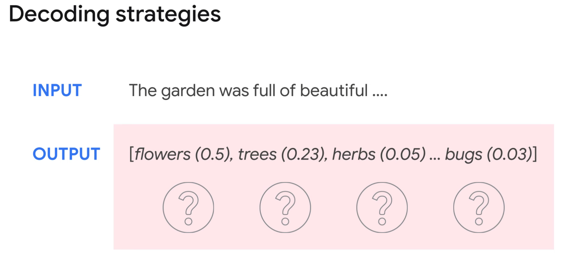

Slide 7
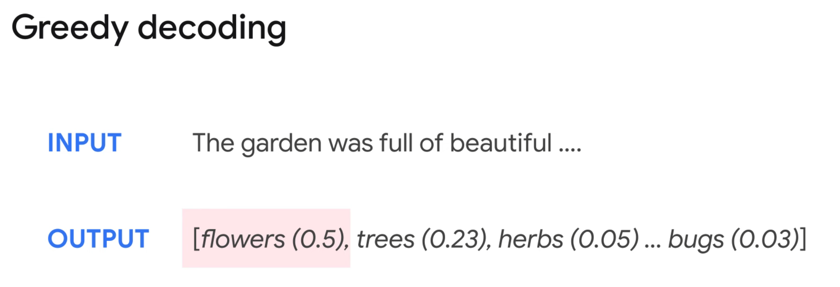

Slide 8
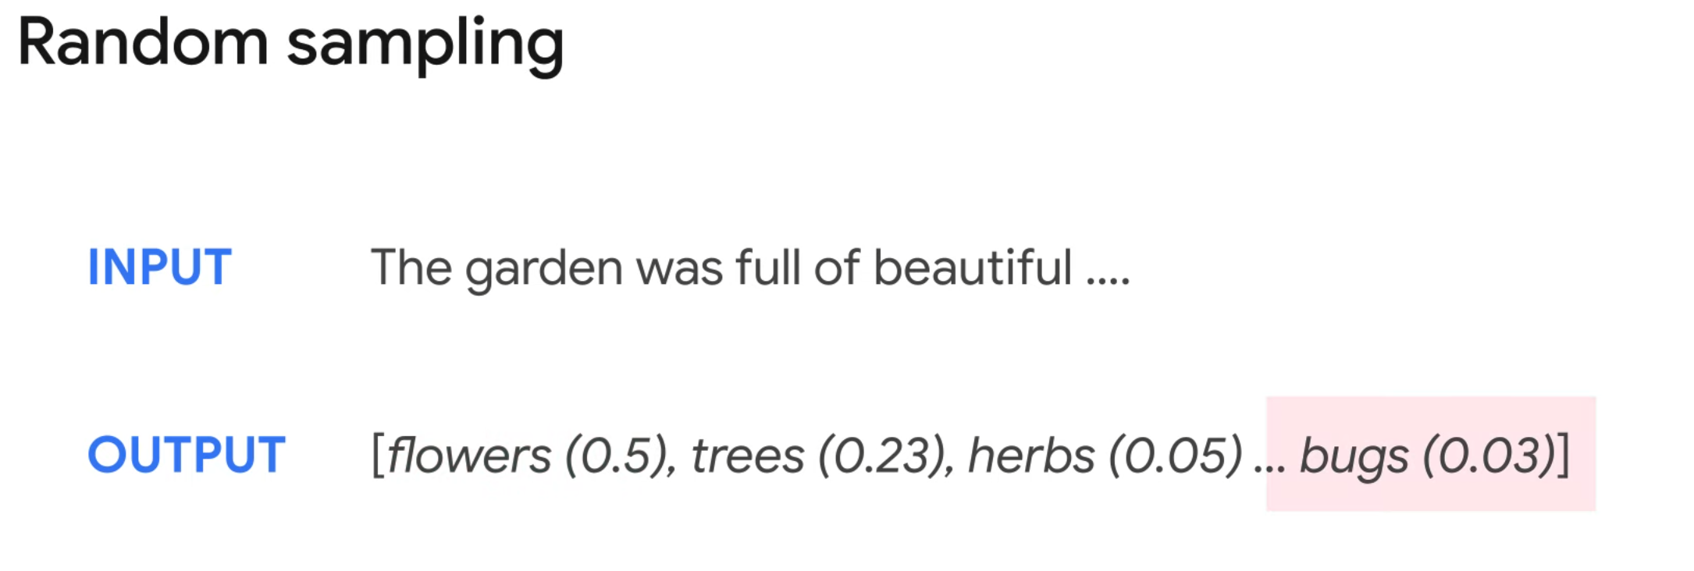

Slide 9
Training LLMs
Notes:
https://www.youtube.com/watch?v=mMwYl5r7yvM

Slide 10
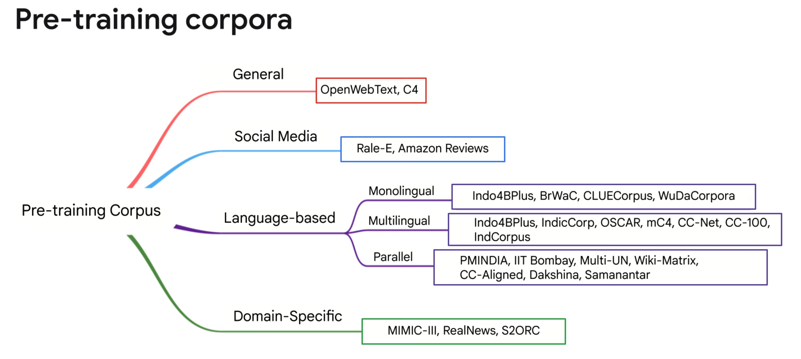

Slide 11
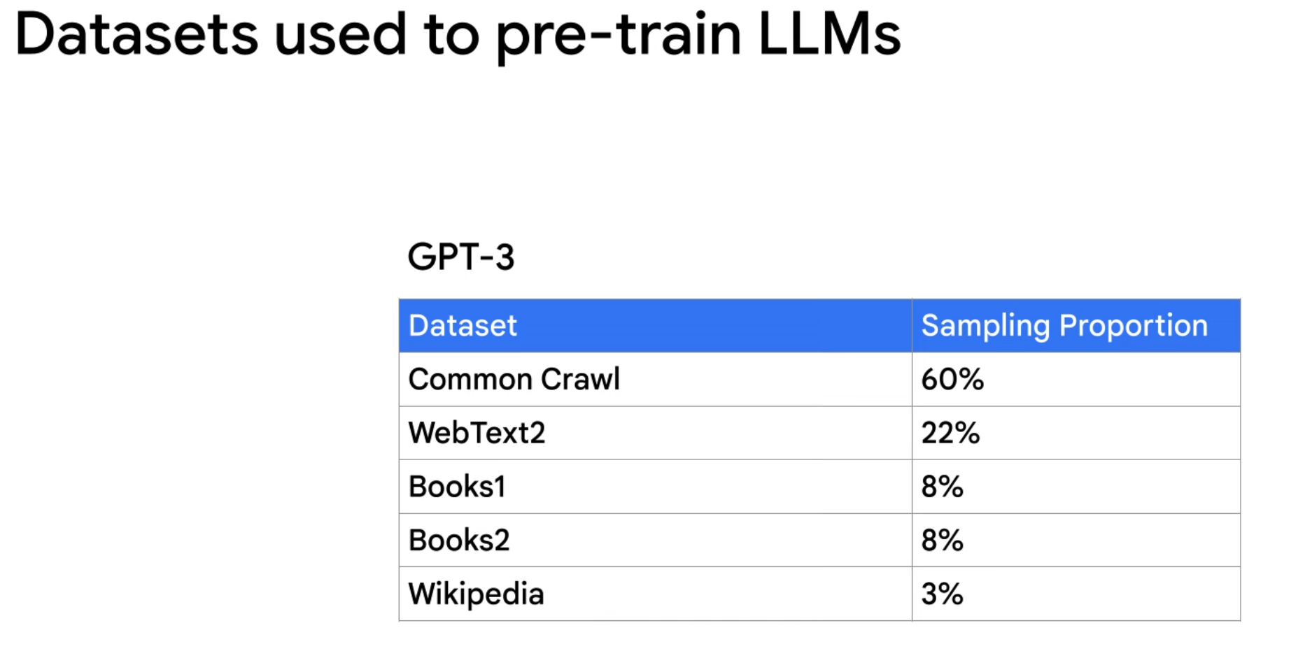

Slide 12
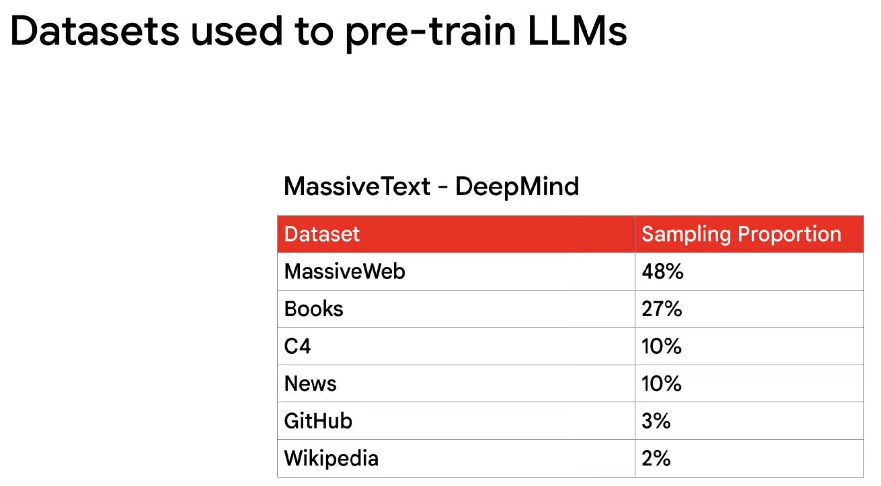

Slide 13
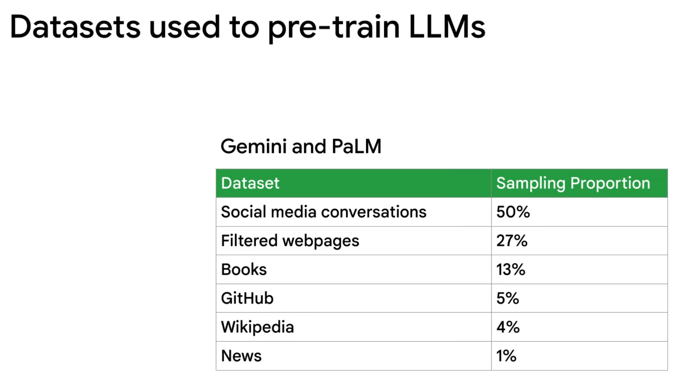

Slide 14
Choosing an LLM model
Notes:
https://www.youtube.com/watch?v=lXFfDE7GBLI

Slide 15
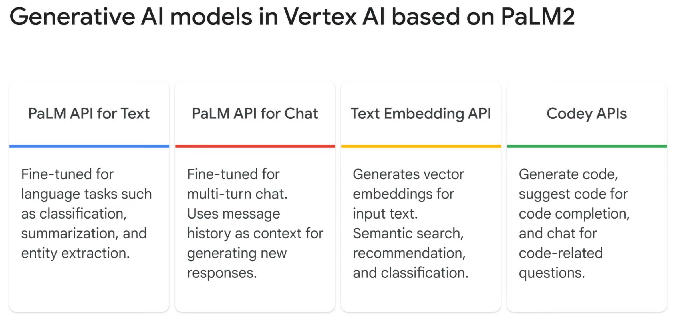

Slide 16
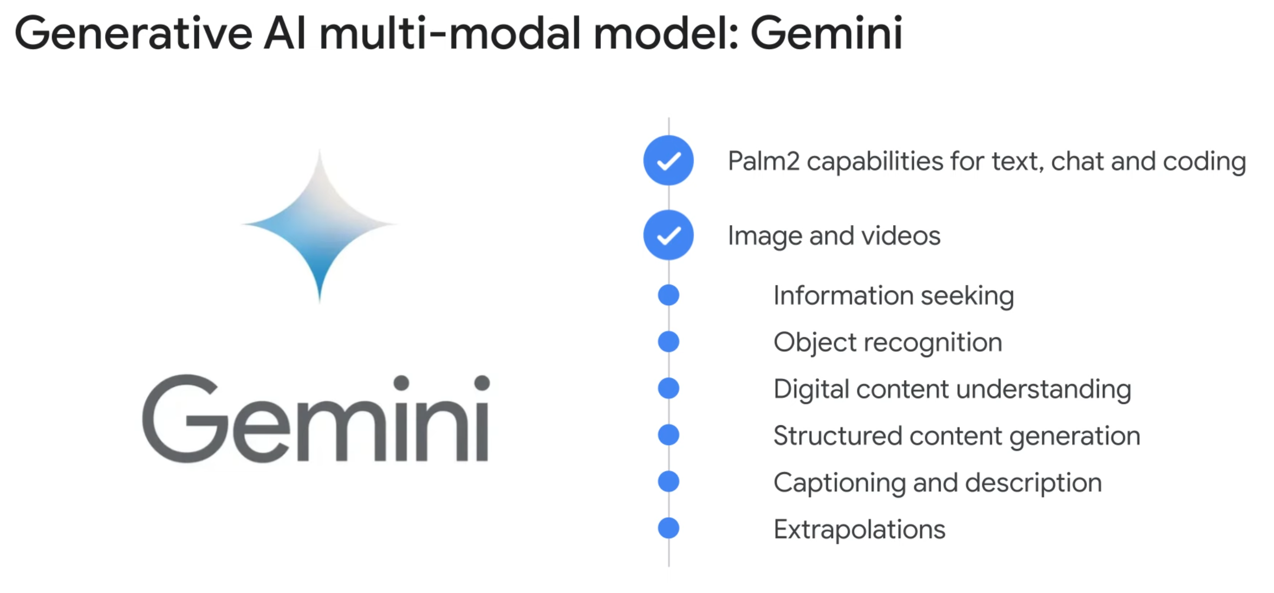

Slide 17
LLM Reliability
Notes:
https://www.youtube.com/watch?v=DxLxz2MkaBA
https://www.youtube.com/watch?v=UpcFtPD1jRA

Slide 18
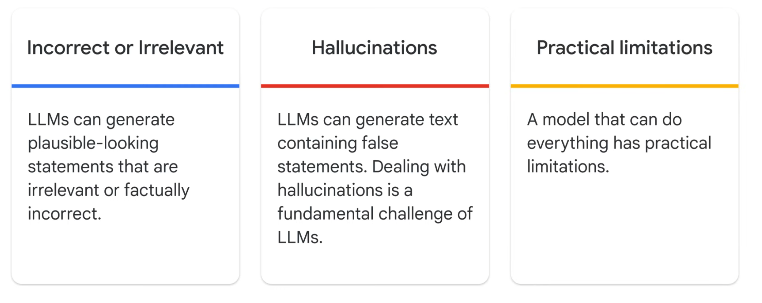

Slide 19
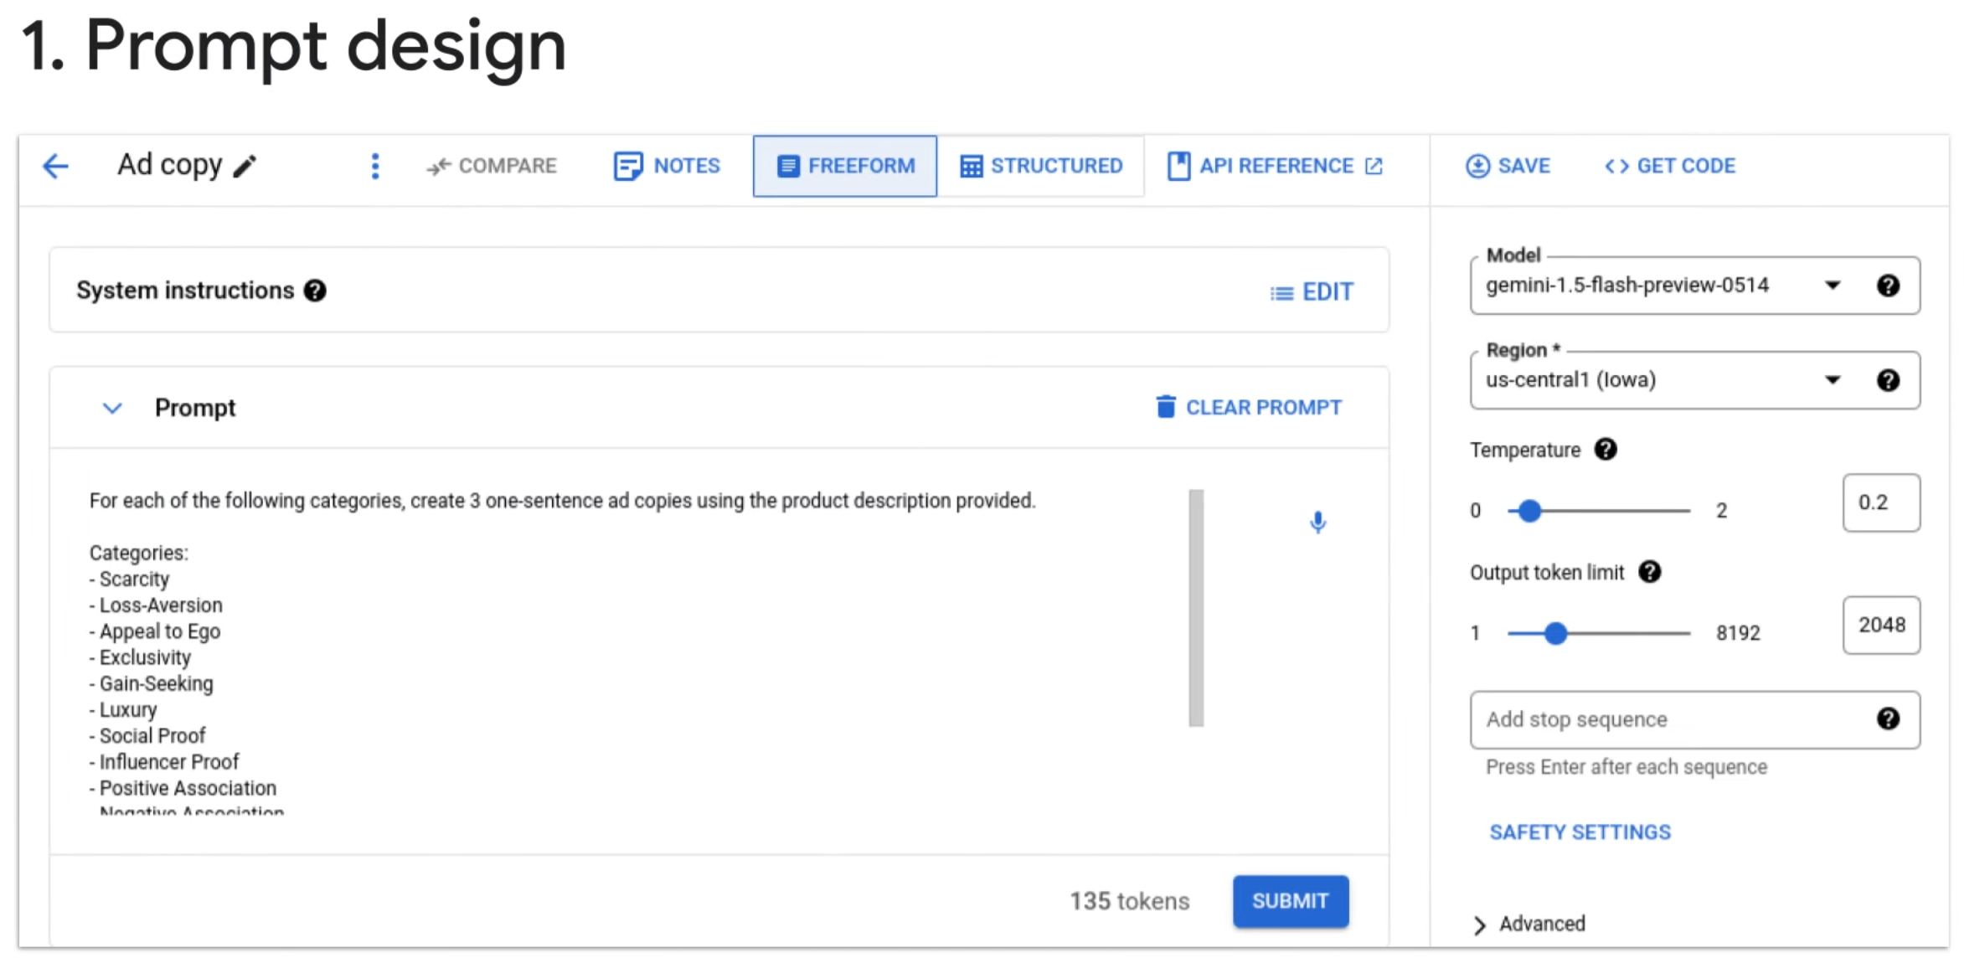

Slide 20
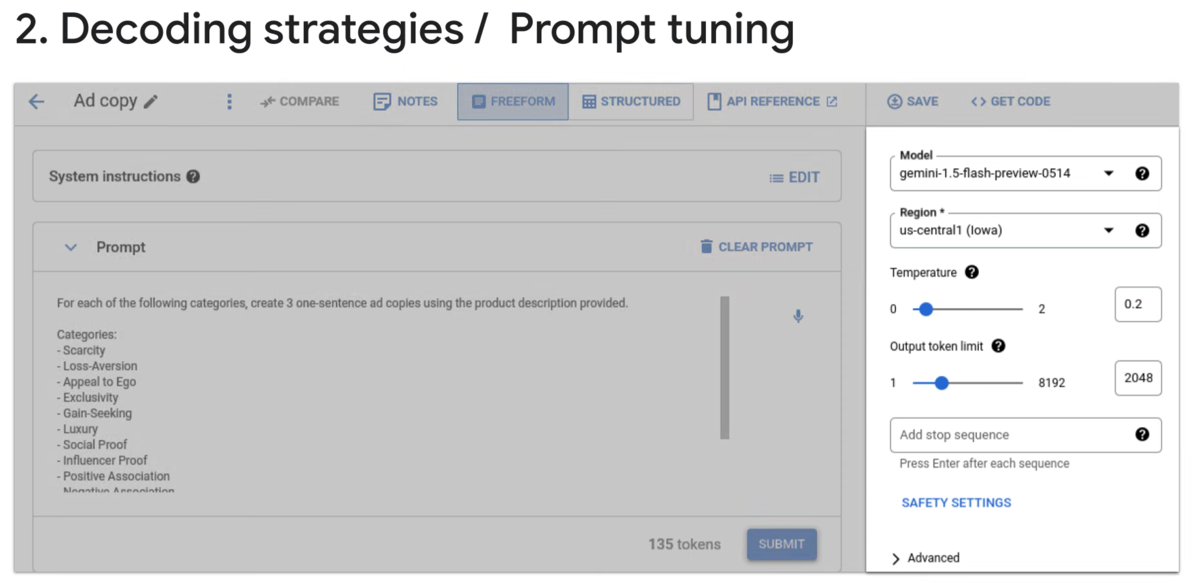

Slide 21
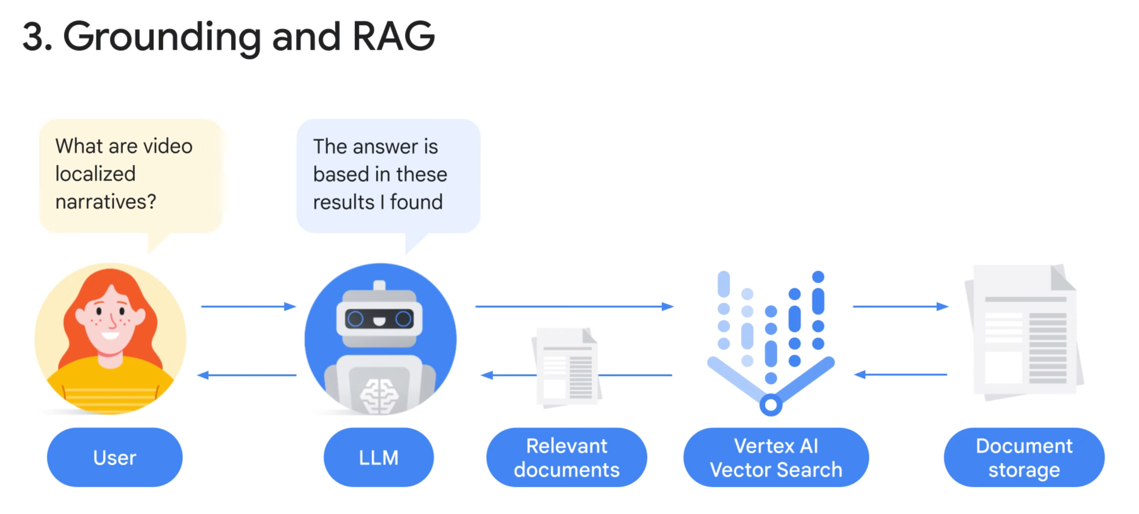

Slide 22
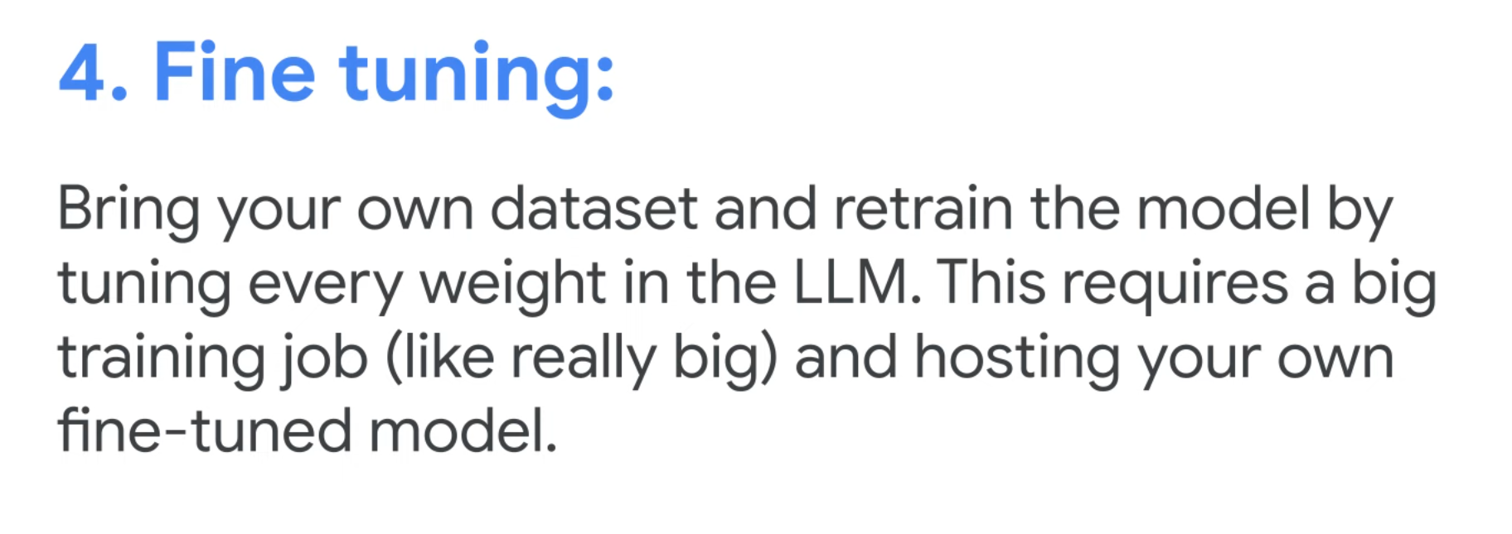

Slide 23
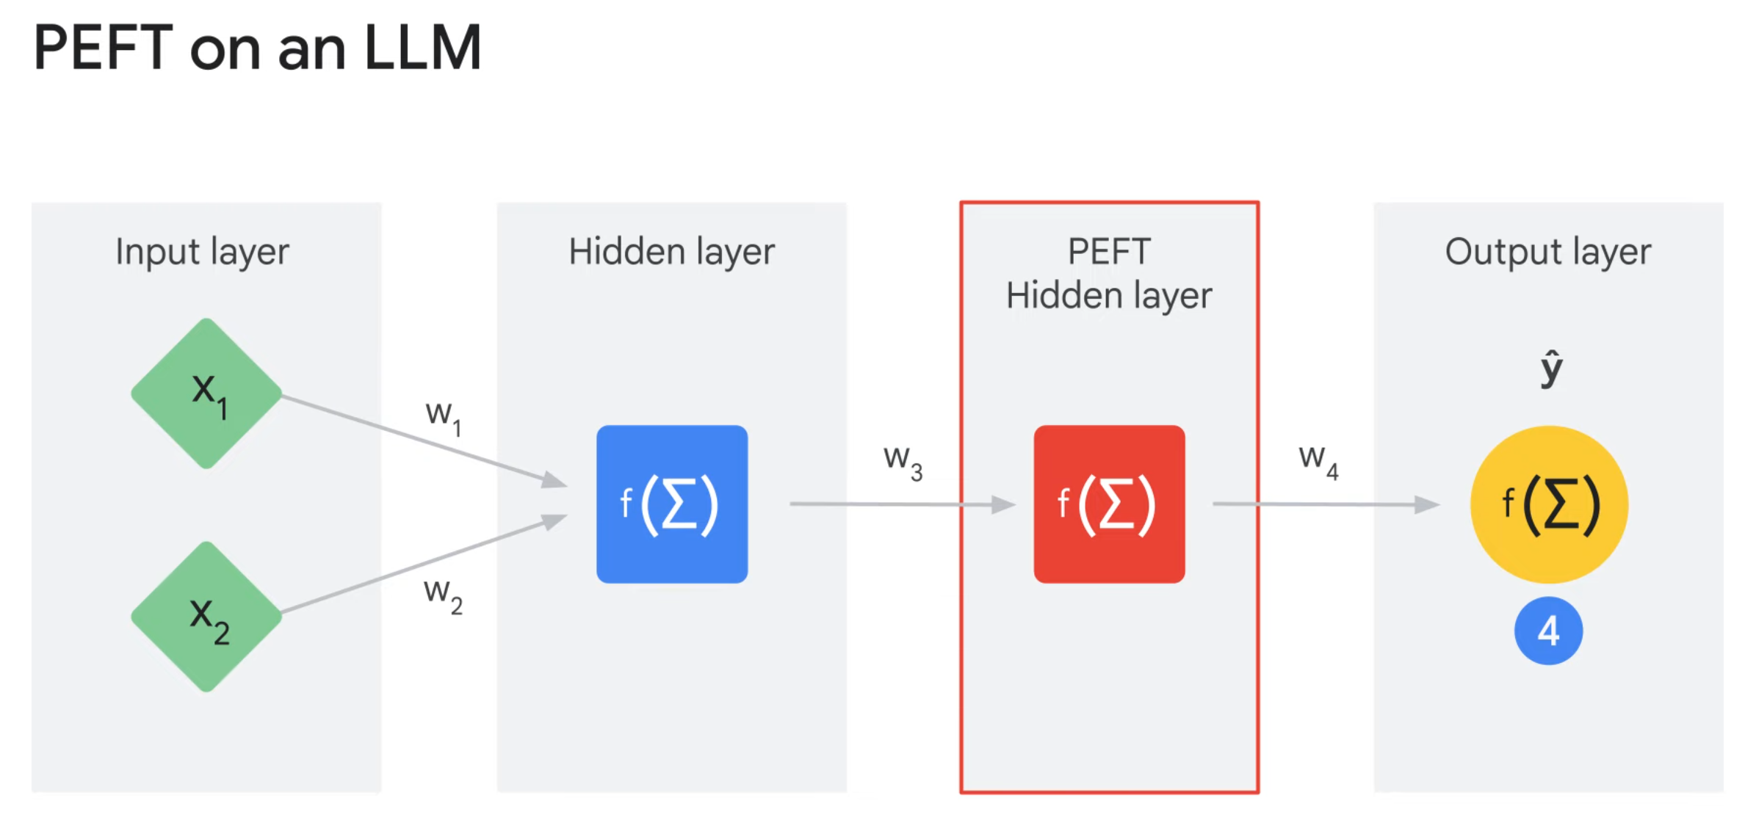

Slide 24
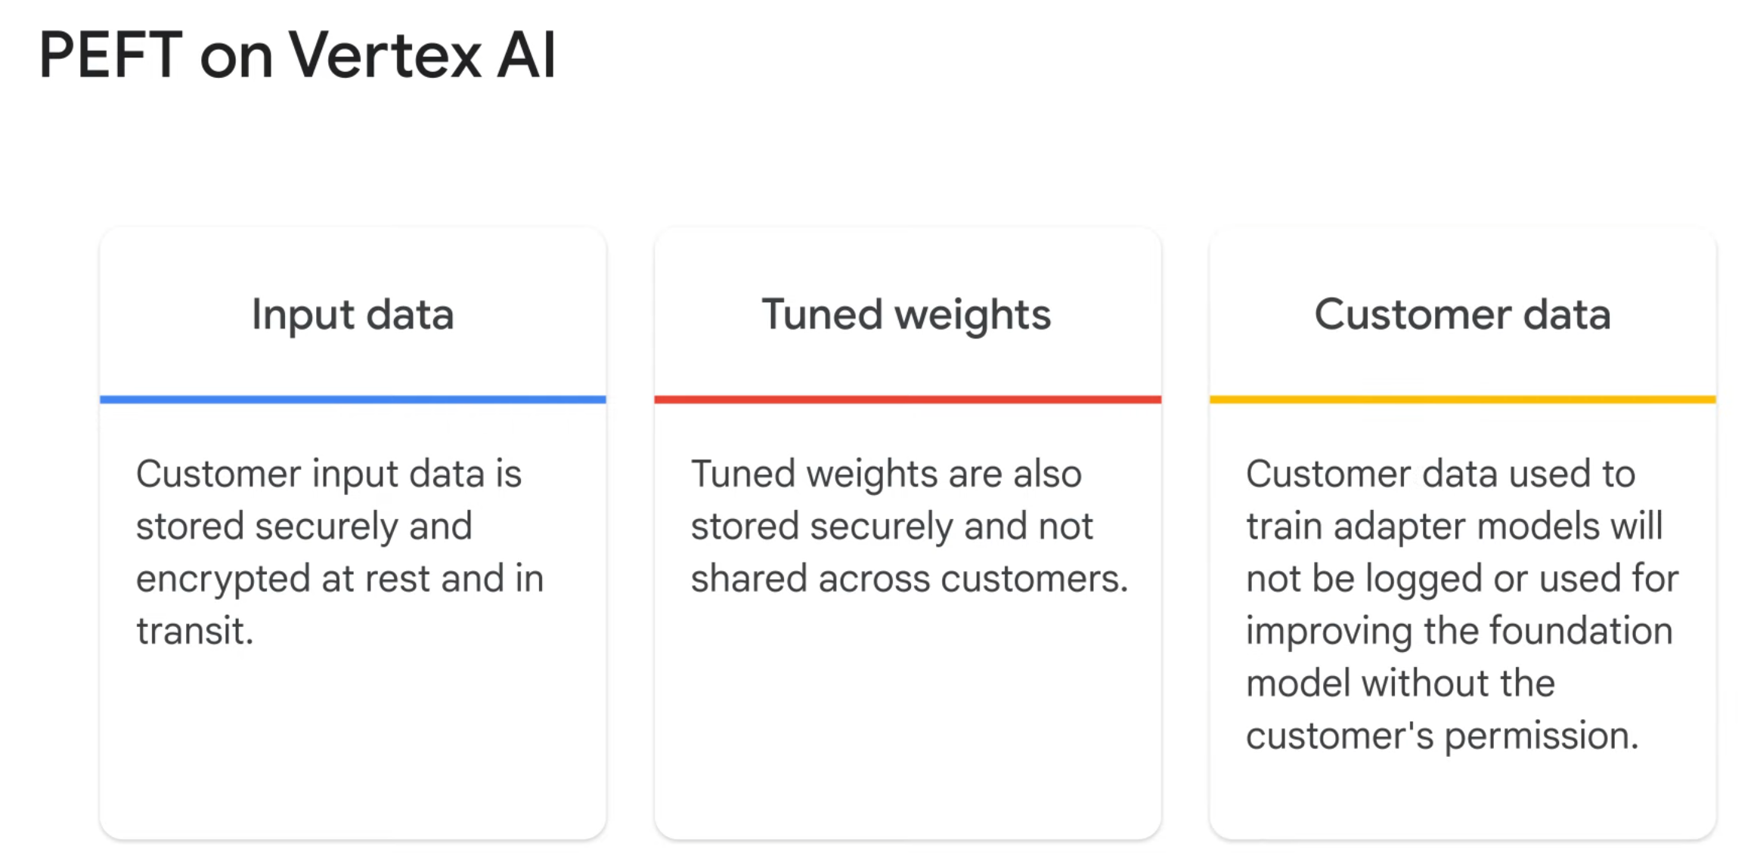

Slide 25
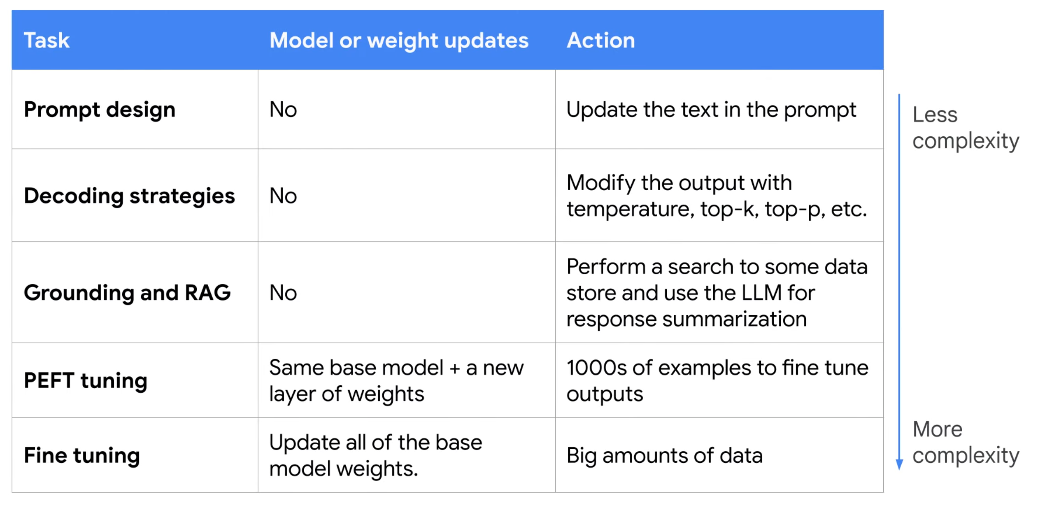

Slide 26
Prompt Design
Notes:
https://www.youtube.com/watch?v=jWFuxA0lCoQ

Slide 27
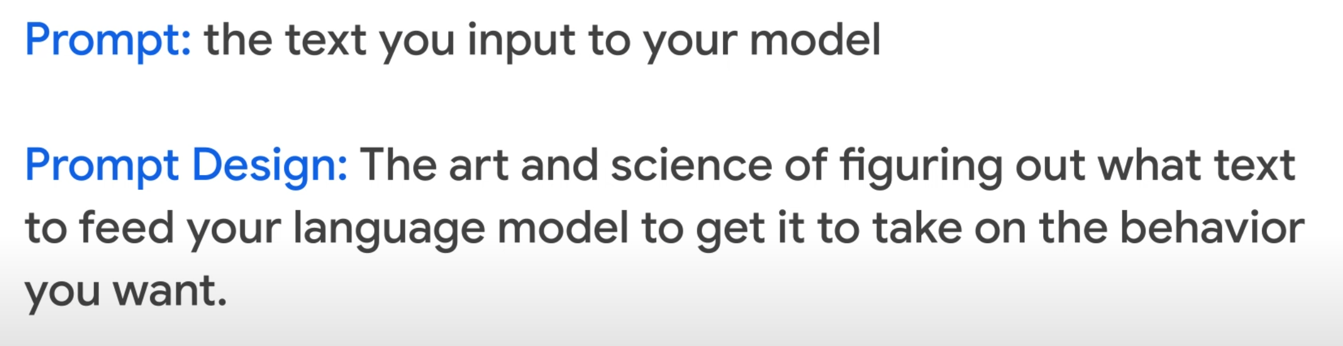

Slide 28
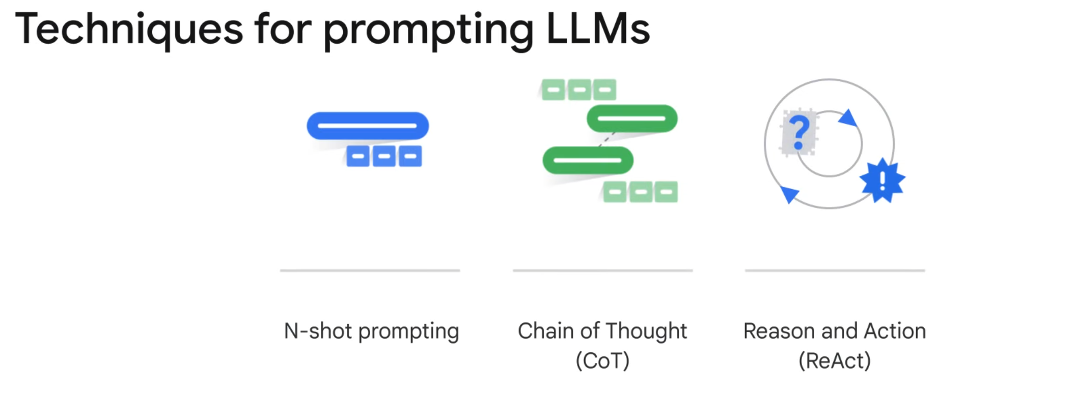

Slide 29
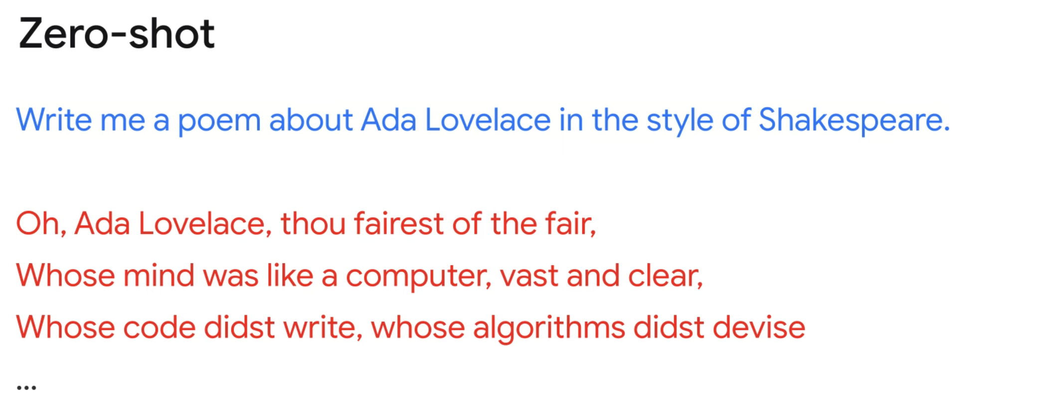

Slide 30
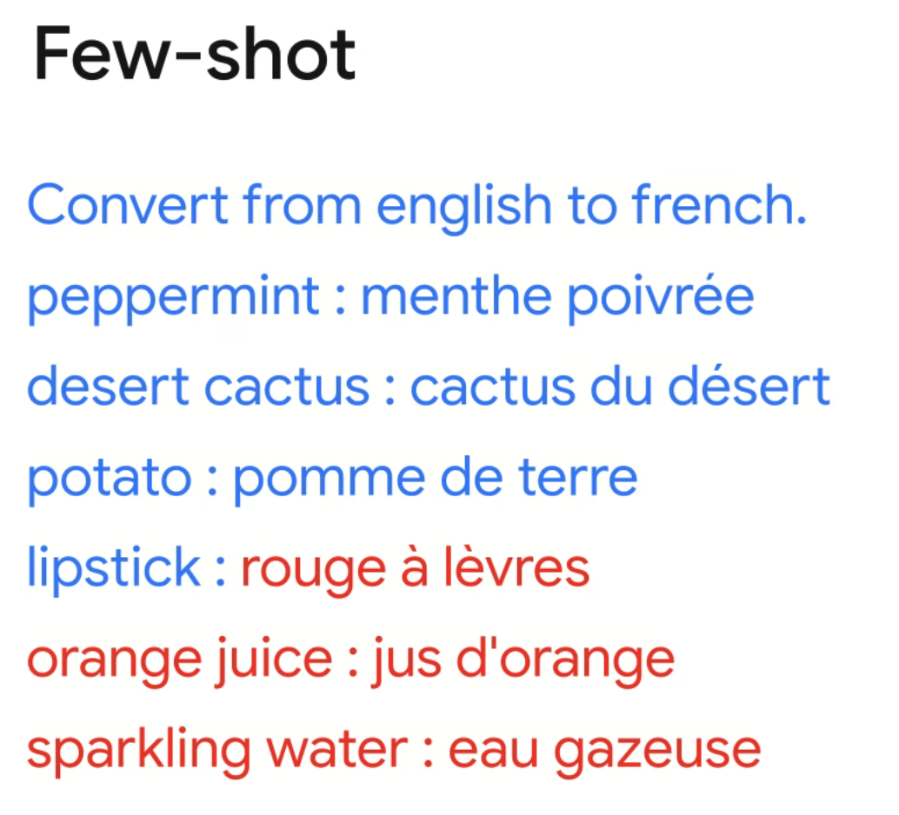

Slide 31
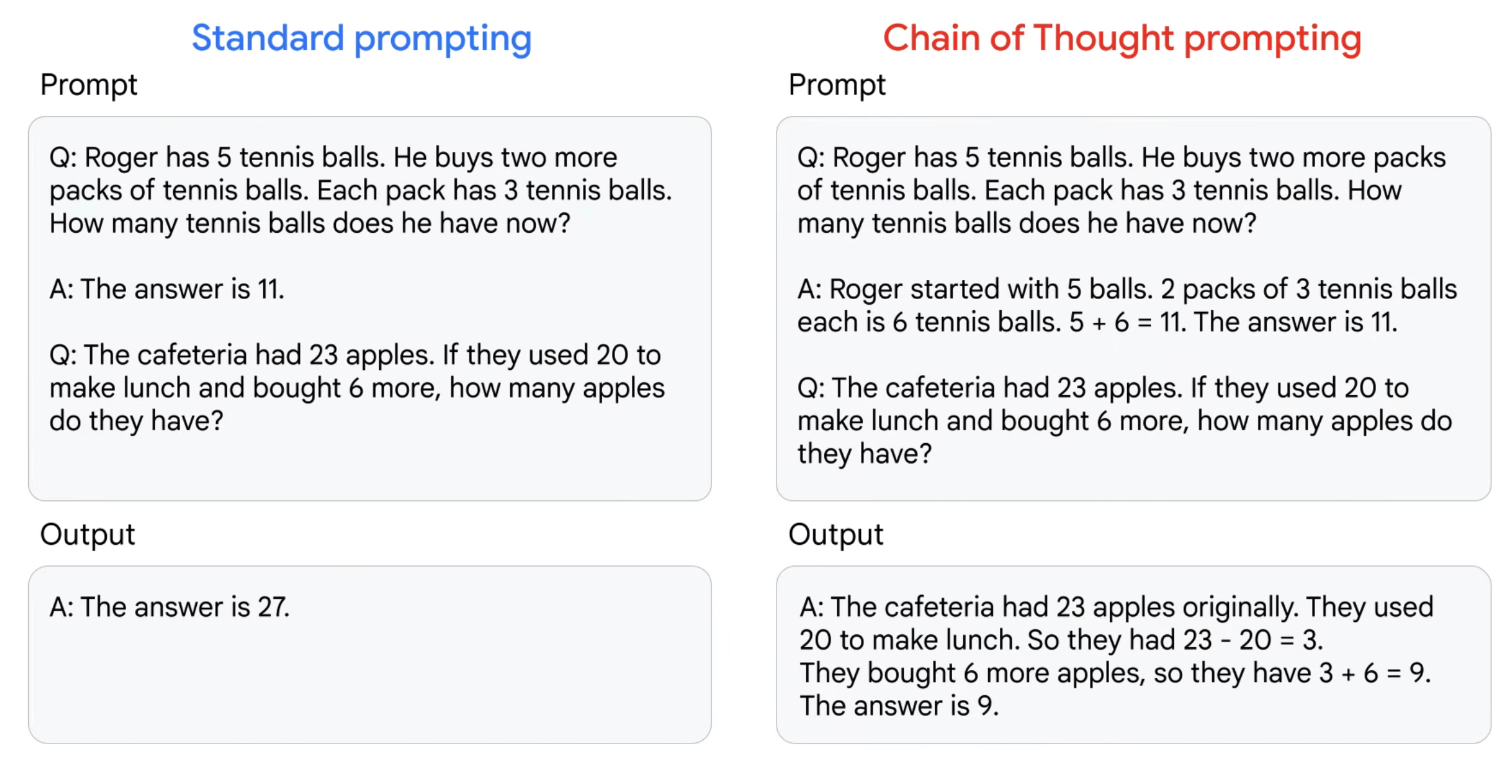

Slide 32
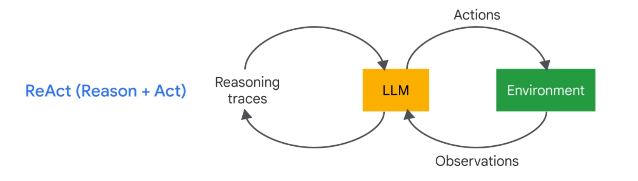

Slide 33
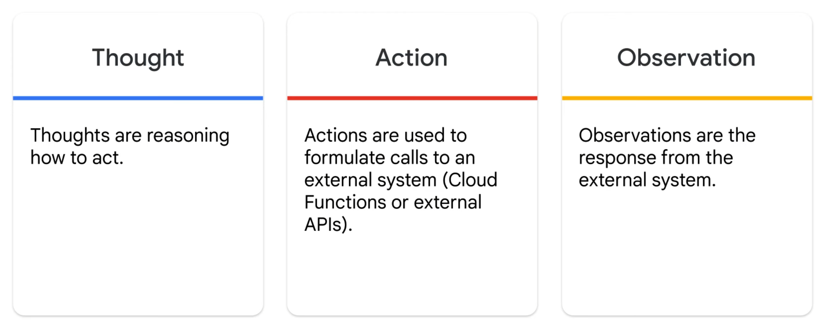

Slide 34
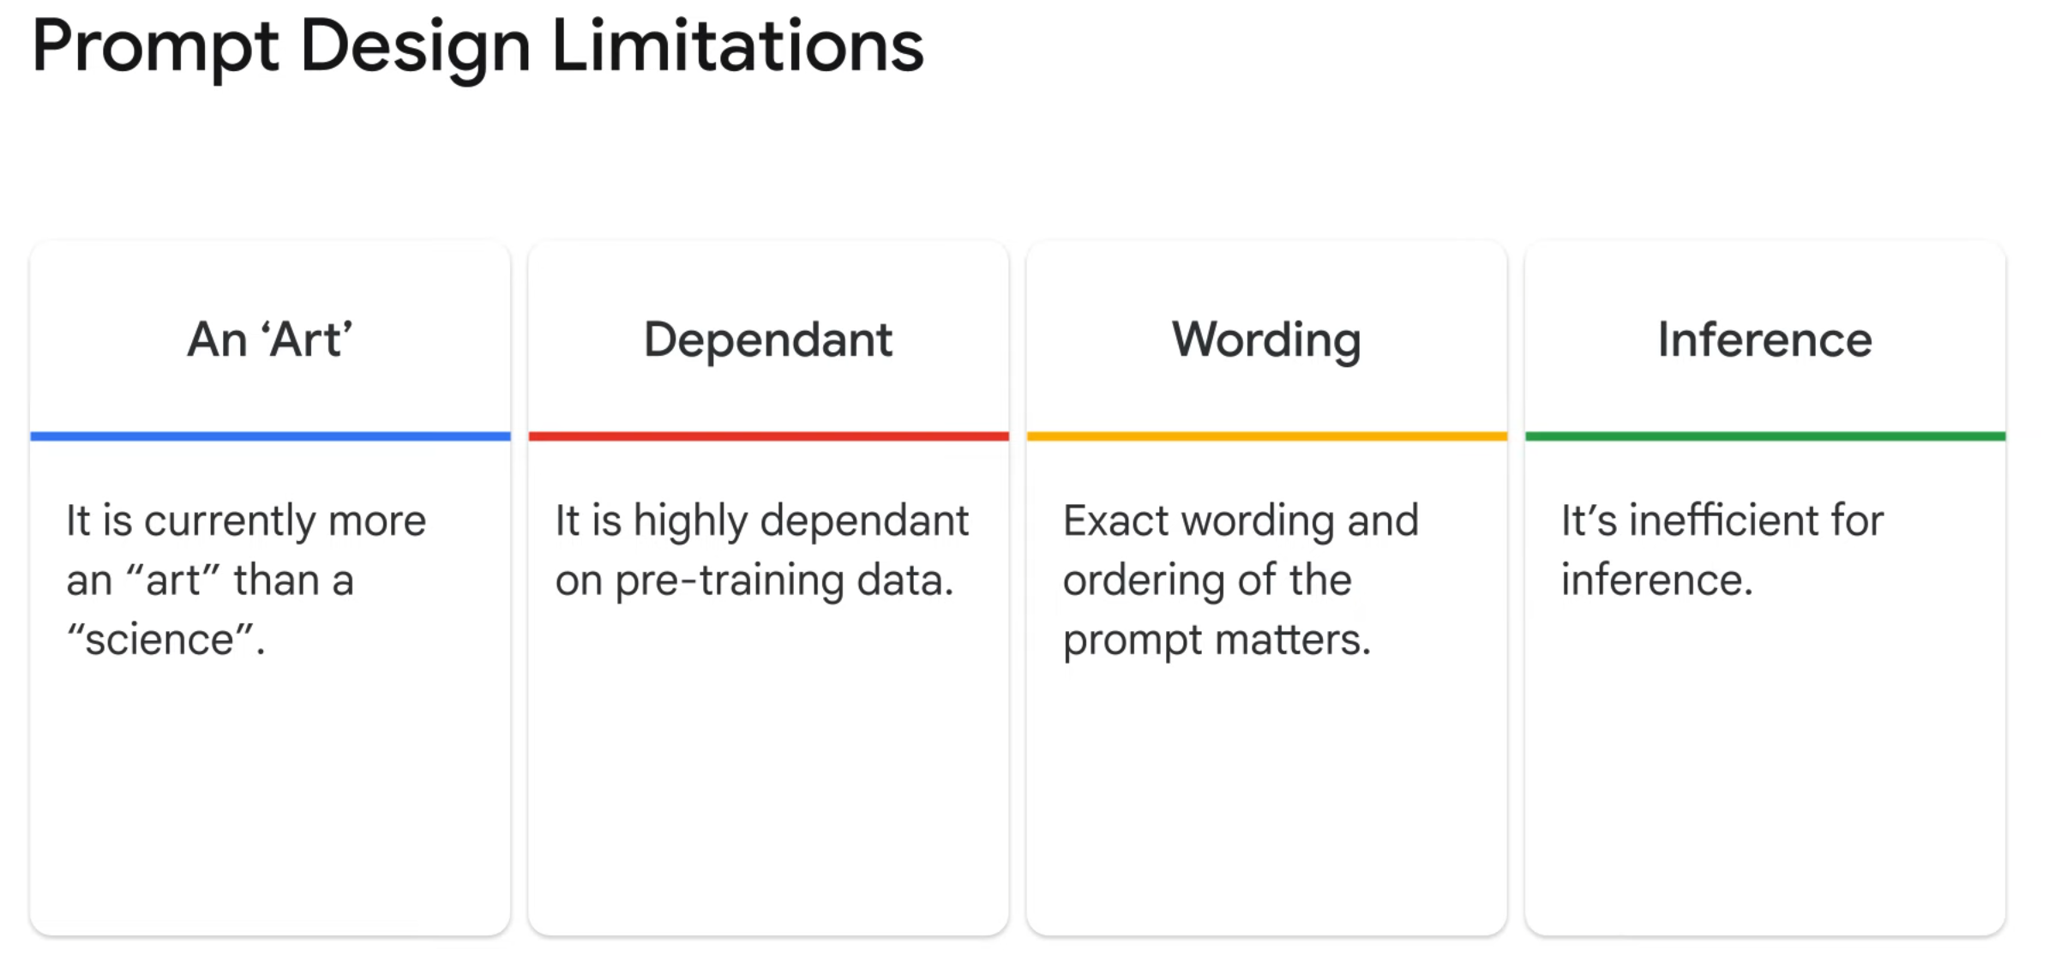

Slide 35


